Slide 1
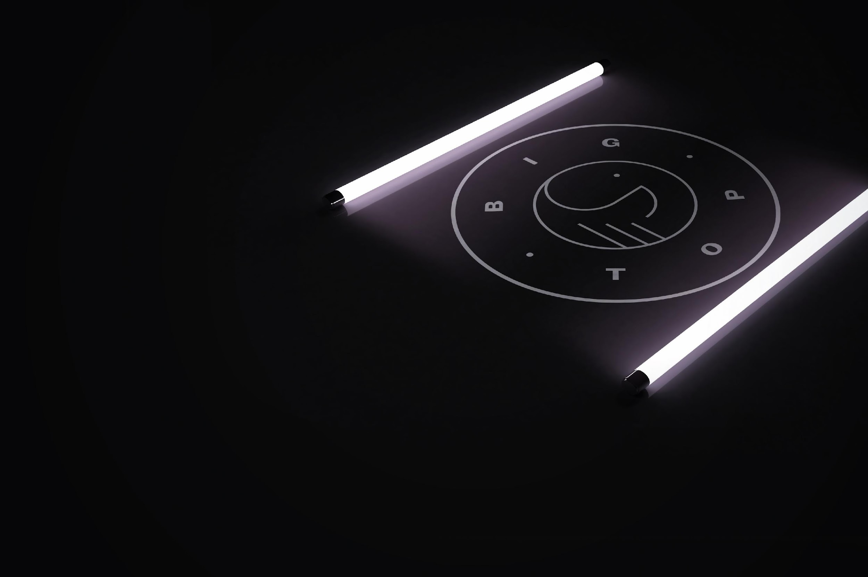
EXHIBITOR PR PACK

Slide 2
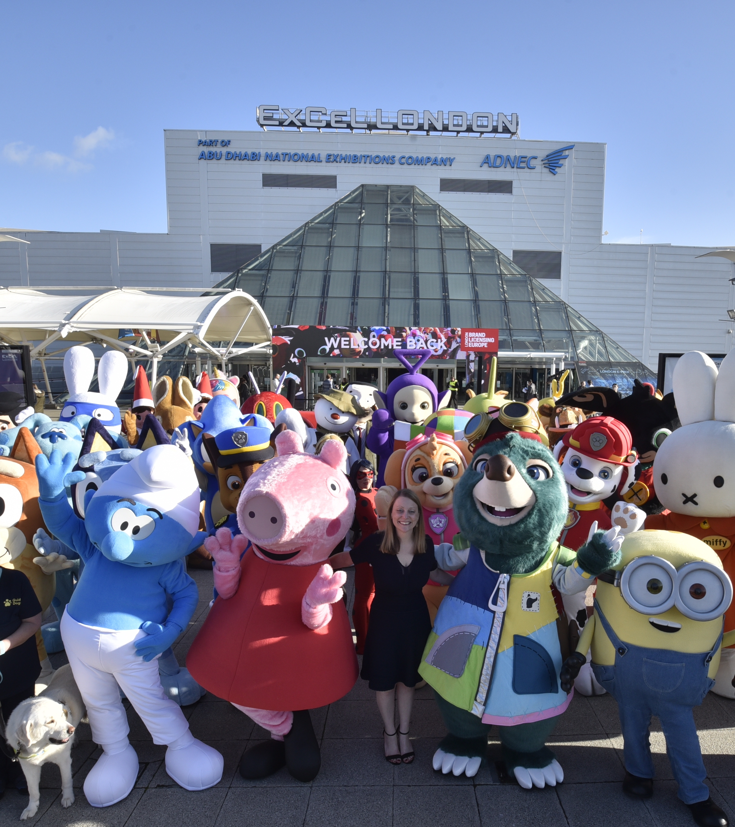
LET'S GET YOU SOME FREE PR
Journalists from influential publications cover Brand Licensing Europe each year, including from all over Europe, the UK and North America.
As a BLE exhibitor, your stories are important, and we can get you free media coverage before and during BLE 2024.
All you need to do is tell us all about your business and the brands you work with, and we will work with you (for free) to make telling your story as easy as possible.
THIS IS A FREE OPPORTUNITY.
BIG TOP IS BLE's OFFICIAL PR AGENCY.

Slide 3
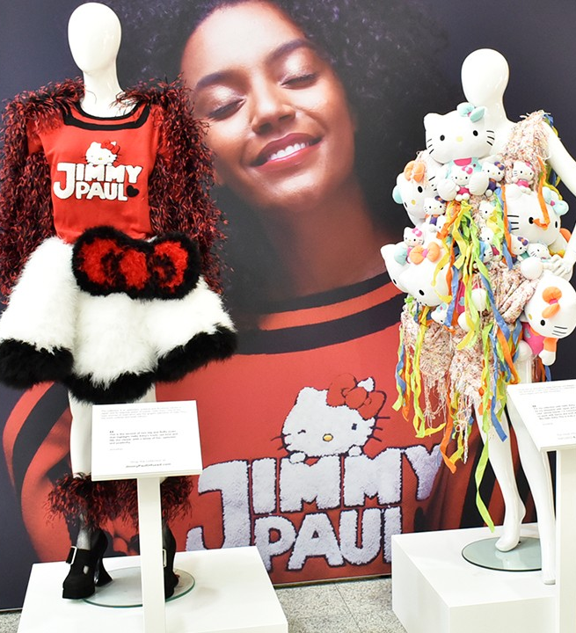
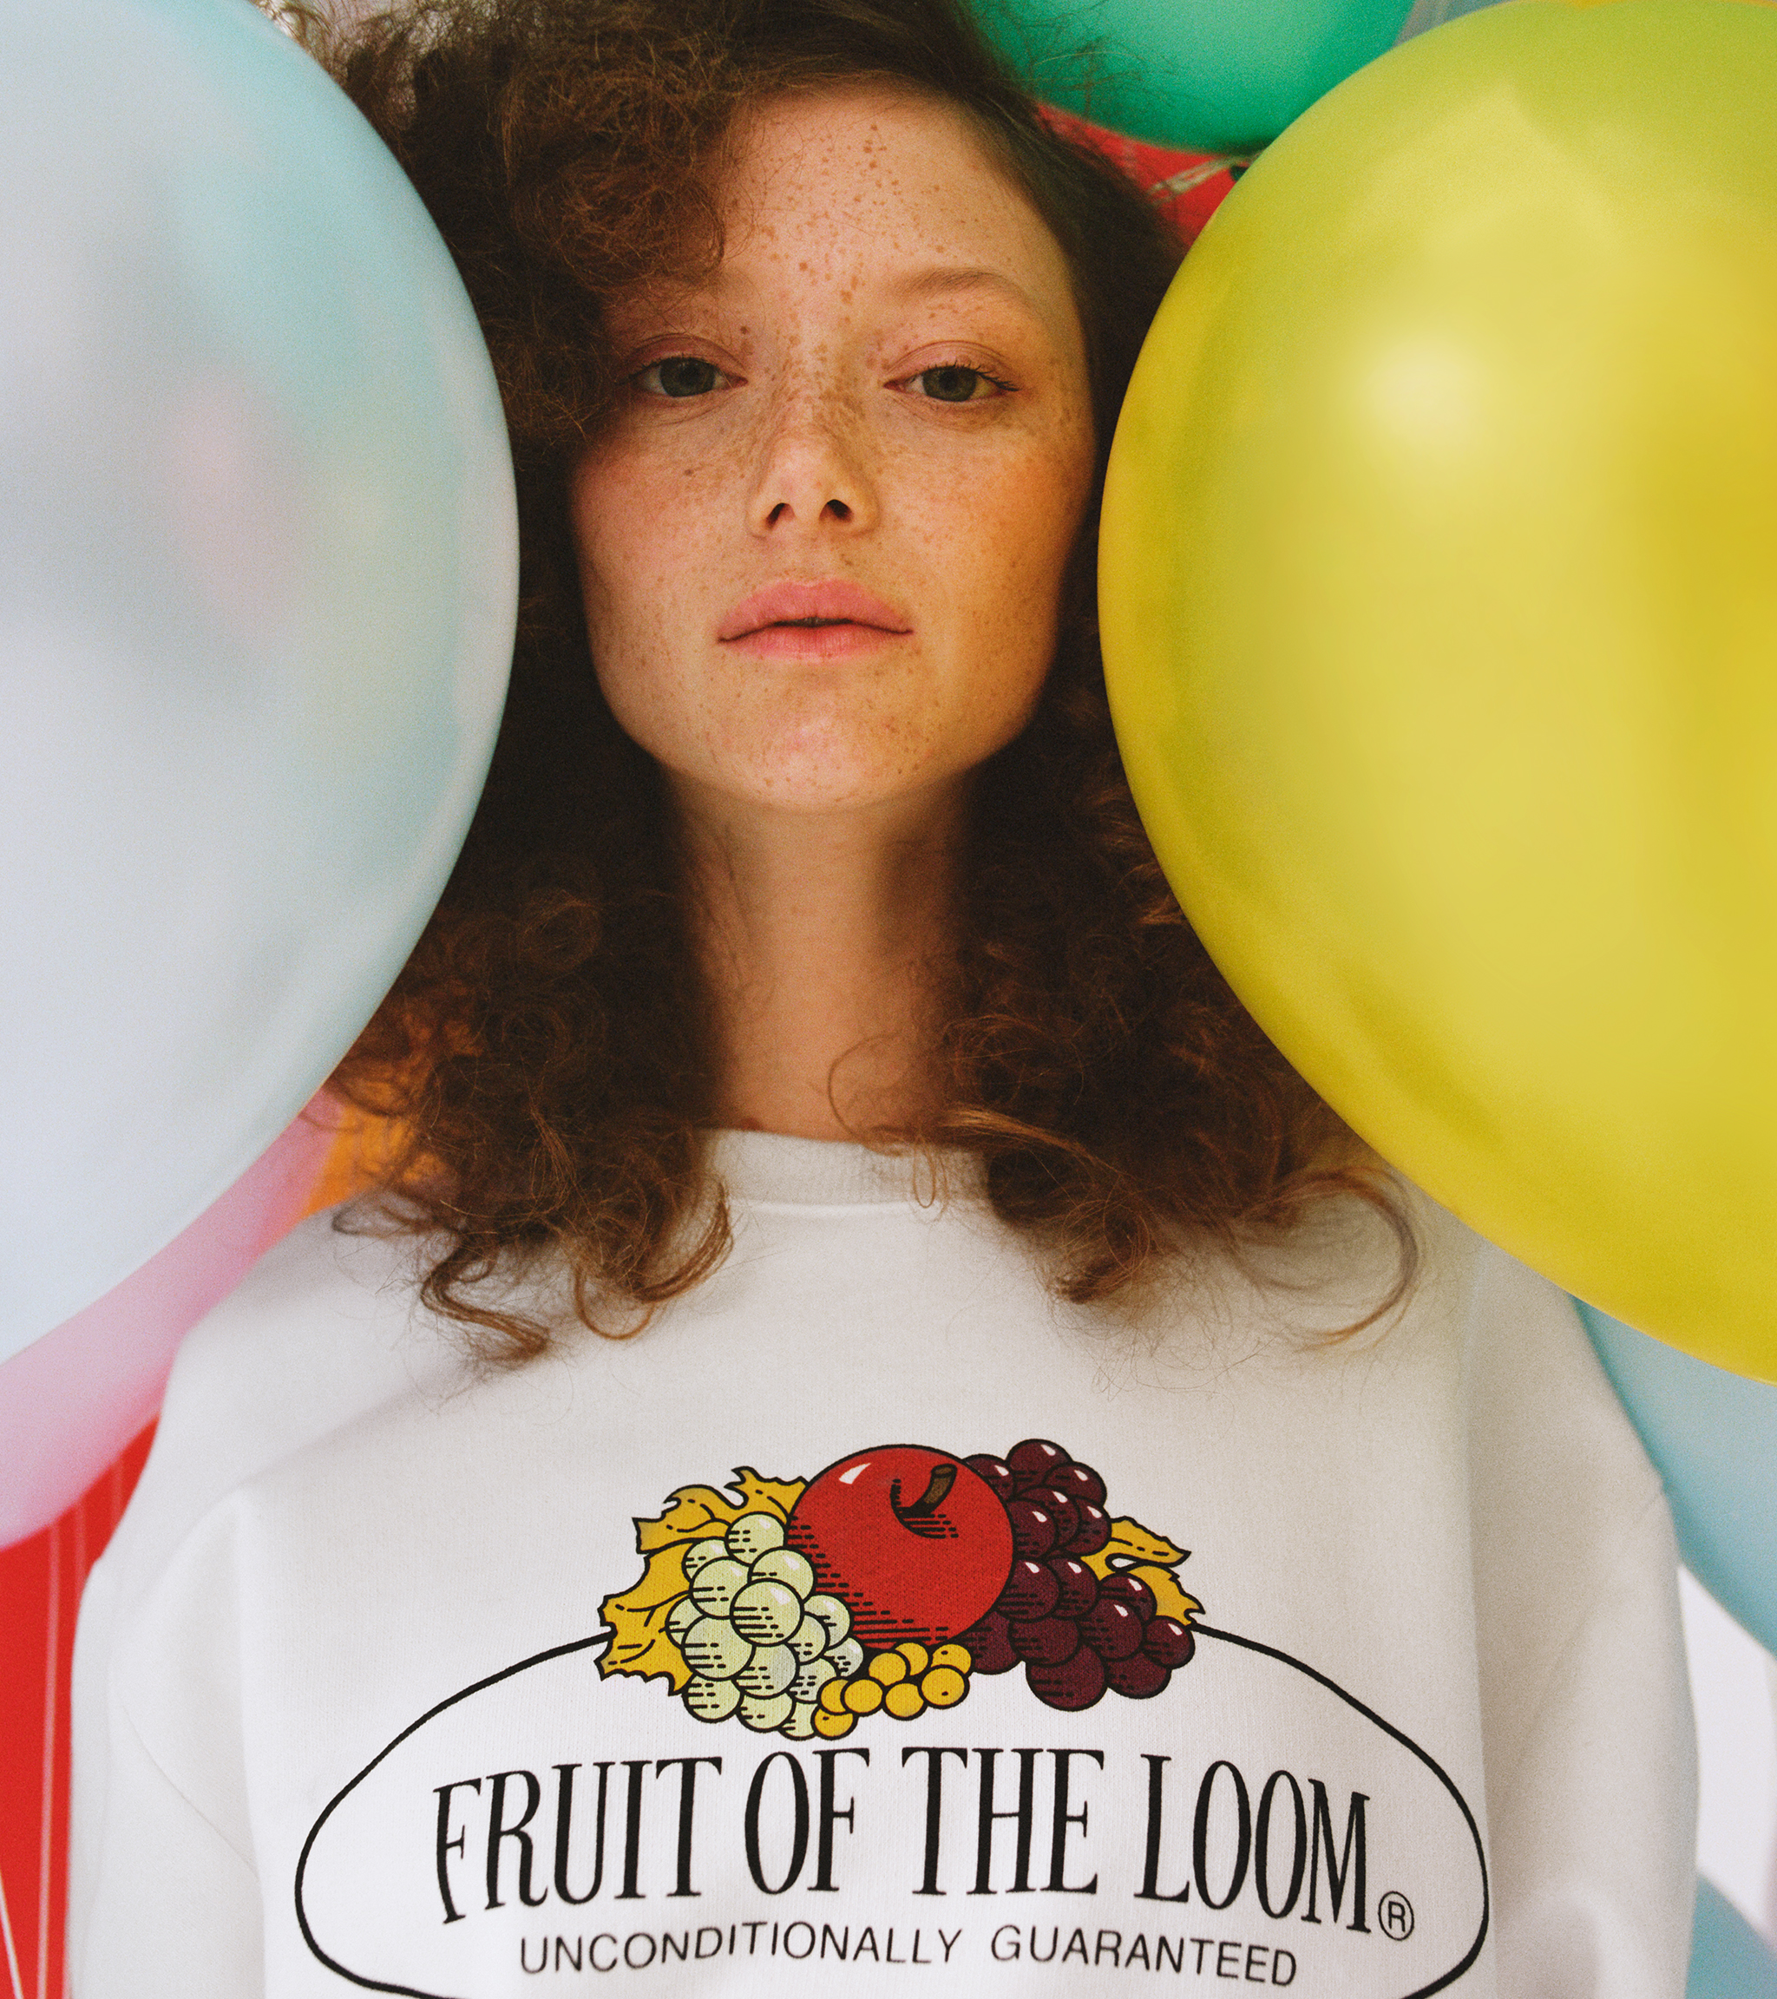
IT’S QUICK AND EASY
The plan is work with you on thought leadership articles, interviews and Q&As to get you media coverage in:
Licensing media in Europe, UK and North America, including License Global
Business media based on the categories you work with – e.g. gifts, toys, homeware, video games
Potentially, national print and broadcast media
You will be able to approve all copy and can we may even be able to help you craft comments and quotes.

Slide 4
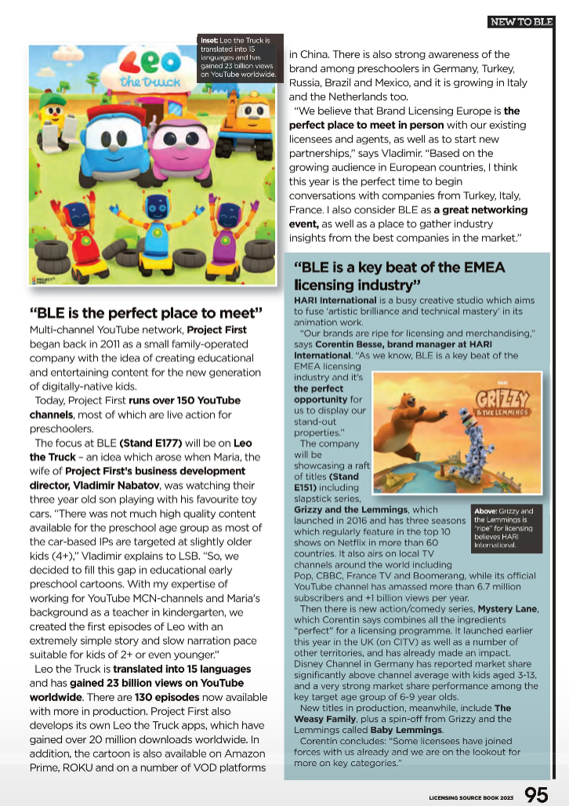
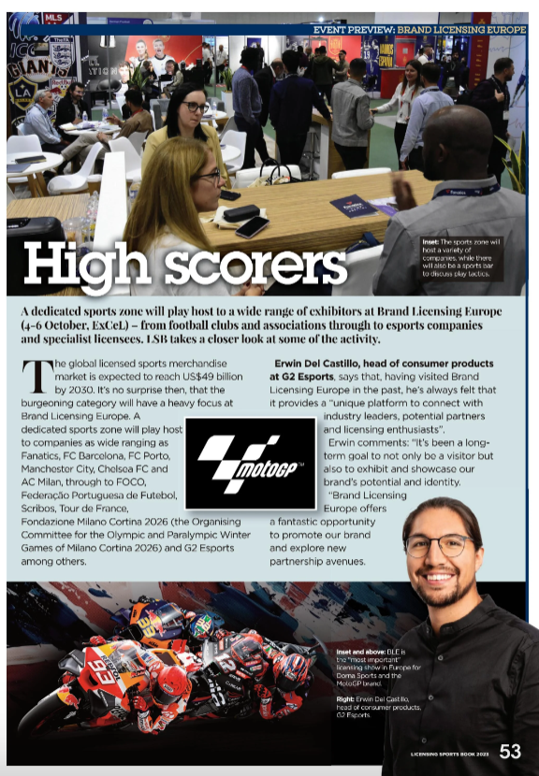
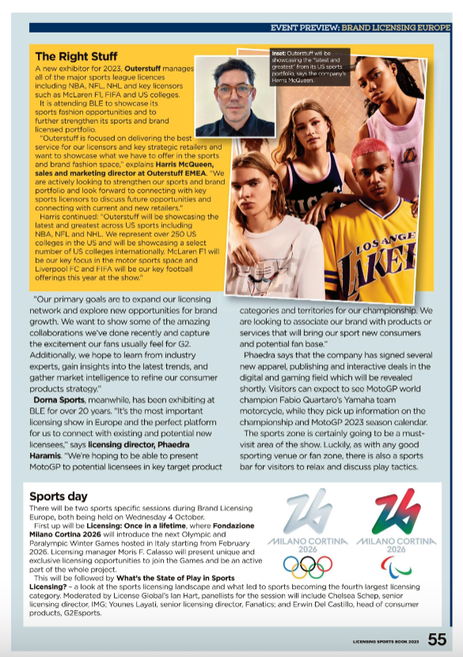
SEE YOUR BRANDS IN THE MEDIA FOR FREE

Slide 5
MEDIA INFORMATION FORM
So, you’re keen to be involved? That’s great news. Remember, this is completely free for BLE exhibitors.
Simply answer the following questions and email them back to us with a fantastic-looking headshot and some product shots and an intro to your PR team (if you have one) at BLE@bigtop-pr.co.uk
Would you like to take part in media interviews before and at BLE? Yes/No
Do you want to write/contribute to thought leadership articles before BLE? Yes/No
Do you want to meet journalists at the show? Yes/No
Tell me about your business and the brands you work with.
You’re returning to exhibit at BLE! Tell me about all the lovely reasons you're coming back.
What can licensees and retailers expect to see on your stand?
Are you launching new brands, products and announcing any news at BLE?
If so, what is it, who is it for why should licensees and retailers be excited by it?
Is there anything else you’d like to tell us about yourself?

Slide 6
BIGTOP
CHARLIE@BIGTOP-PR.CO.UK
07736 330676

